Slide 1
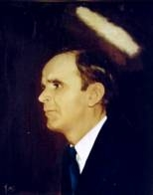

191
PAST THE CURTAIN OF TIME
There’s a curtain that’s drawn between
earth and Heaven,
And just beyond lies a beautiful clime
Where the evils of this life no longer can
touch me;
Lord, let me look past the curtain of time.

Slide 2
CHORUS
Lord, let me look past the curtain of sorrows and fear,
Let me view that sunny bright clime;
It would strengthen my faith and would
banish all fear;
Lord, let me look past the curtain of time.

Slide 3
I’m helpless, alone, and I want to see Jesus,
And hear the sweet harbor bells chime,
Where my friends and dear loved ones are waiting for me;
Lord, let me look past the curtain of time.

Slide 4
I’m so homesick and blue, and I want to see Jesus,
I would like to hear those sweet harbor bells chime;
It would brighten my path and would vanish all fear;
Lord, let me look past the curtain of time.

